Slide 1
AngularJS Jumpstart
Let’s bind

Slide 2
Table of Contents
General information
Project setup
Routing and Views
Controllers & Binding with $scope
Directives
Services/Factories

Slide 3
General information
Developed by Google
Initial Release 2009
MIT License
Client Side Model-View-Controller
Wikipedia: “AngularJS is built on the belief that declarative programming should be used to create user interfaces and connect software components,…”

Slide 4
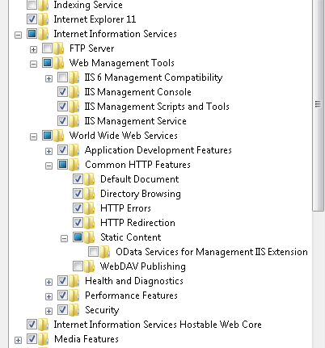
Project setup
Brackets K:\Zentrale_Logistik\LIT\Betrieb\Developers\Tools\brackets
Git-scm K:\Zentrale_Logistik\LIT\Betrieb\Developers\Tools\GitScm
Clone empty project
Git clone https://github.com/muehan/AngularJumpstart.git
Host directory with IIS or Apache

Slide 5
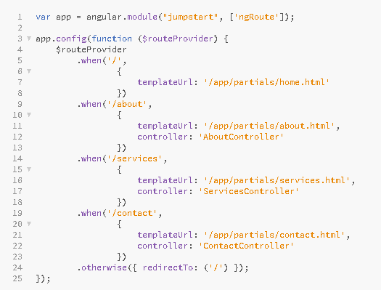
Routing and Views

Slide 6
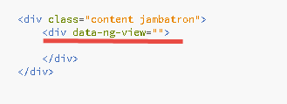
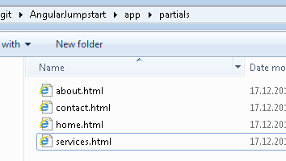
Routing and Views
Index.hmtl

Slide 7
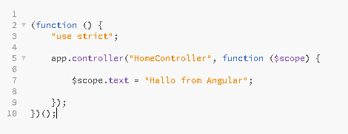
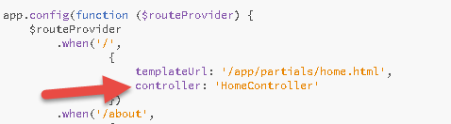
Controllers & Binding with $scope
app/controller/HomeController.js
app/app.js

Slide 8
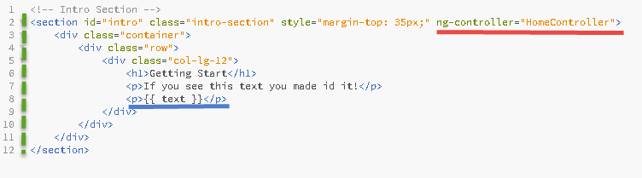
Controllers & Binding with $scope
app/partials/home.html

Slide 9
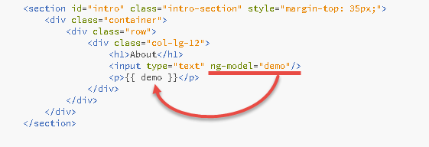
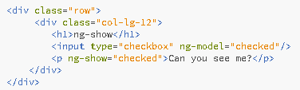
Directives
ng-model
ng-show

Slide 10
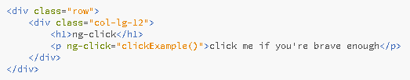

Directives
ng-click

Slide 11
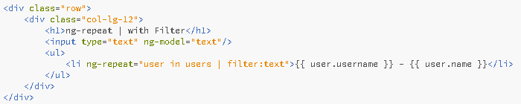
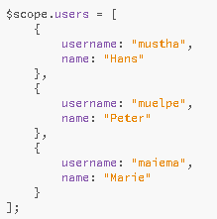
Directives
ng-repeat

Slide 12
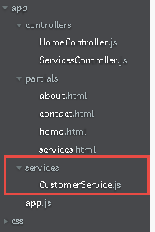
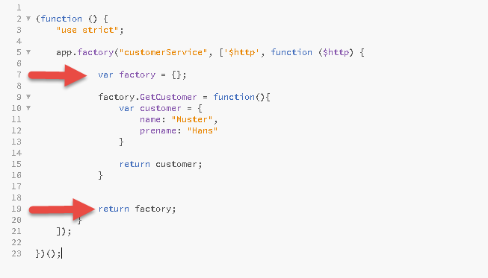
Services/Factories

Slide 13
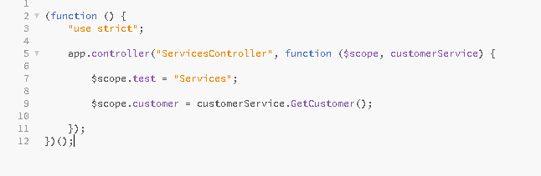
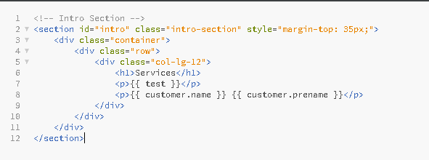
Services/Factories
app/controllers/serviceController.js
app/partials/service.html

Slide 14
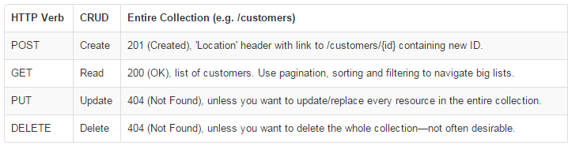
Services/Factories
http://chst3v207:6666/api/customers
REST => Representational State Transfer
$http: AngularDoc

Slide 15
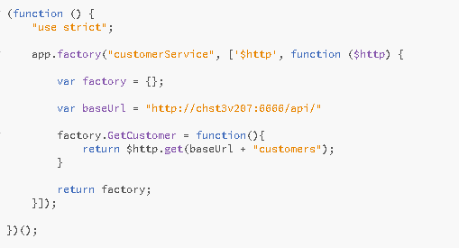
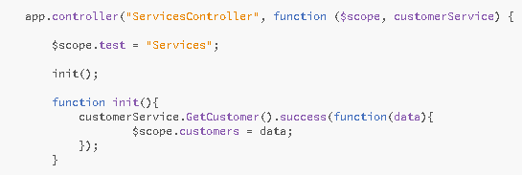
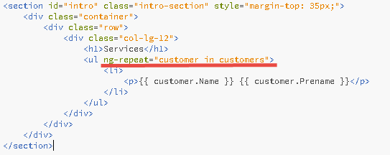
Services/Factories
CustomerService
CustomerController
ServicePartial

Slide 16
Next steps
Authentication / Authorization
Testing => angularDoc
$resources / odata => angularDoc

Slide 17
Finally
https://www.youtube.com/watch?v=kkBsNU16O0E

